Slide 1
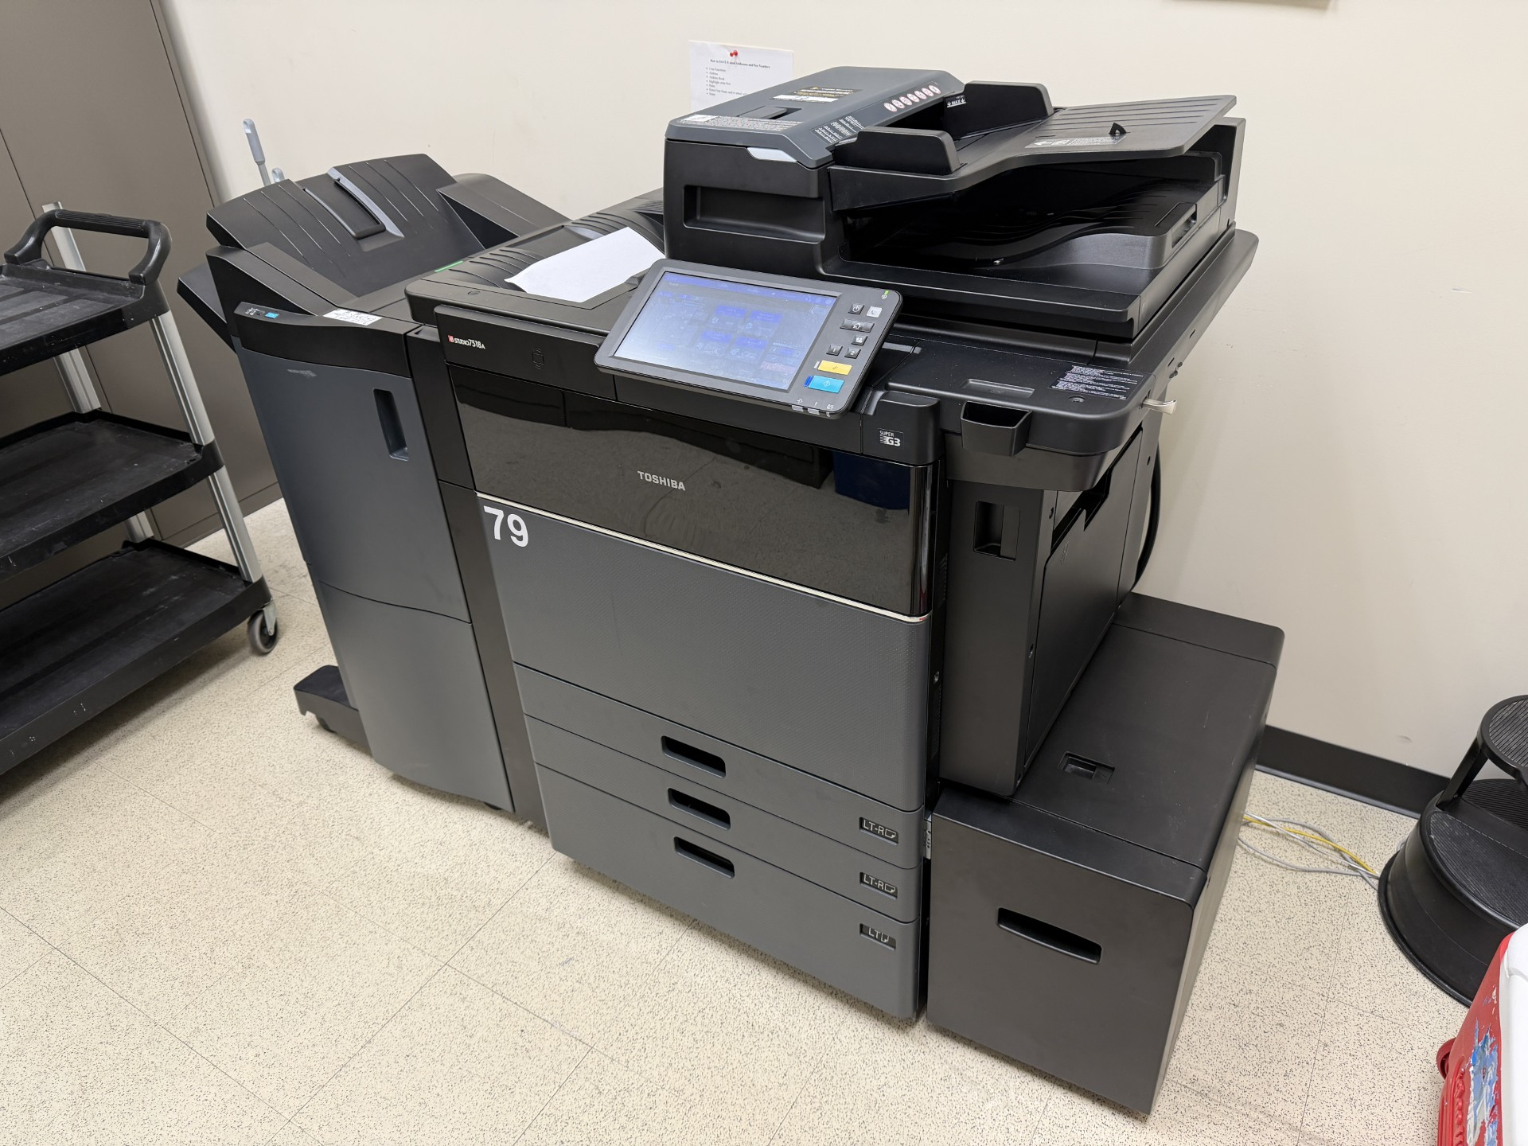
COPY “The ULTIMATE” Contact Manager
Team #1
Processes for Object Oriented Software Development (COP 4331C) – Spring 2026 – Section 3 with Dr. Aashish Yadavally

Slide 2

What is COPY?
COPY stands for "The Contact Organizer for POOSD with Yadavally." COPY is the website built by Team 1 for the Small Project assignment required by the Processes of Object-Oriented Software Development (aka "POOSD" or COP 4331C) at the University of Central Florida (UCF) in Orlando, FL.
Our section of the course (section 3) is being taught by Dr. Aashish Yadavally during the Spring 2026 semester. Thanks to the name, the website is revolved around an office theme. This website implements the LAMP tech stack (Linux, Apache, MySQL, and PHP) and is hosted on a DigitalOcean server with a domain purchased from GoDaddy.com. COPY was designed to be an easy way to manage your own personal contact list. COPY supports the following features:
Adding new contacts
Deleting existing contacts
Editing existing contacts
Searching through contacts (including partial matching)
The website is at https://copycm.com and you can find the GitHub Repository at https://github.com/ABetinsky/cop4331-sm-project

Slide 3
About The Team

Slide 4
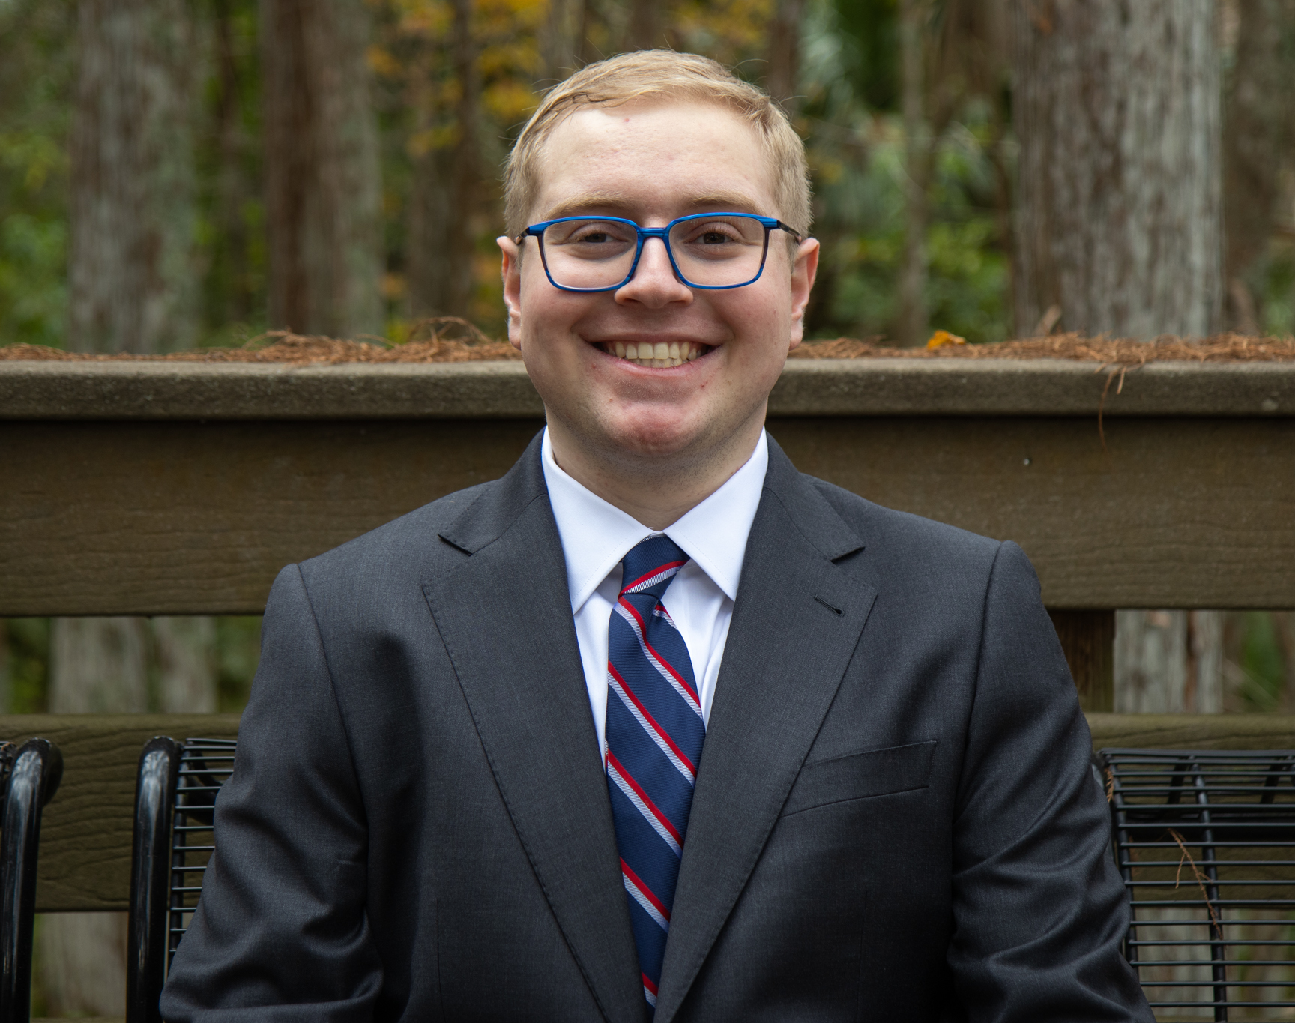
Adam Betinsky Project Manager & Frontend Developer
Adam’s Contributions to COPY Include:
Organizing weekly team meetings and a Discord Server for communication
Providing an initial idea of what the Frontend could look like
Tidying the Frontend for any issues with formatting, colors, images, etc
Organizing the GitHub Repository
Constructing the Gantt Chart, Lighthouse Reports, and The Final Presentation

Slide 5

Benjamin Quintero Frontend Developer

Slide 6
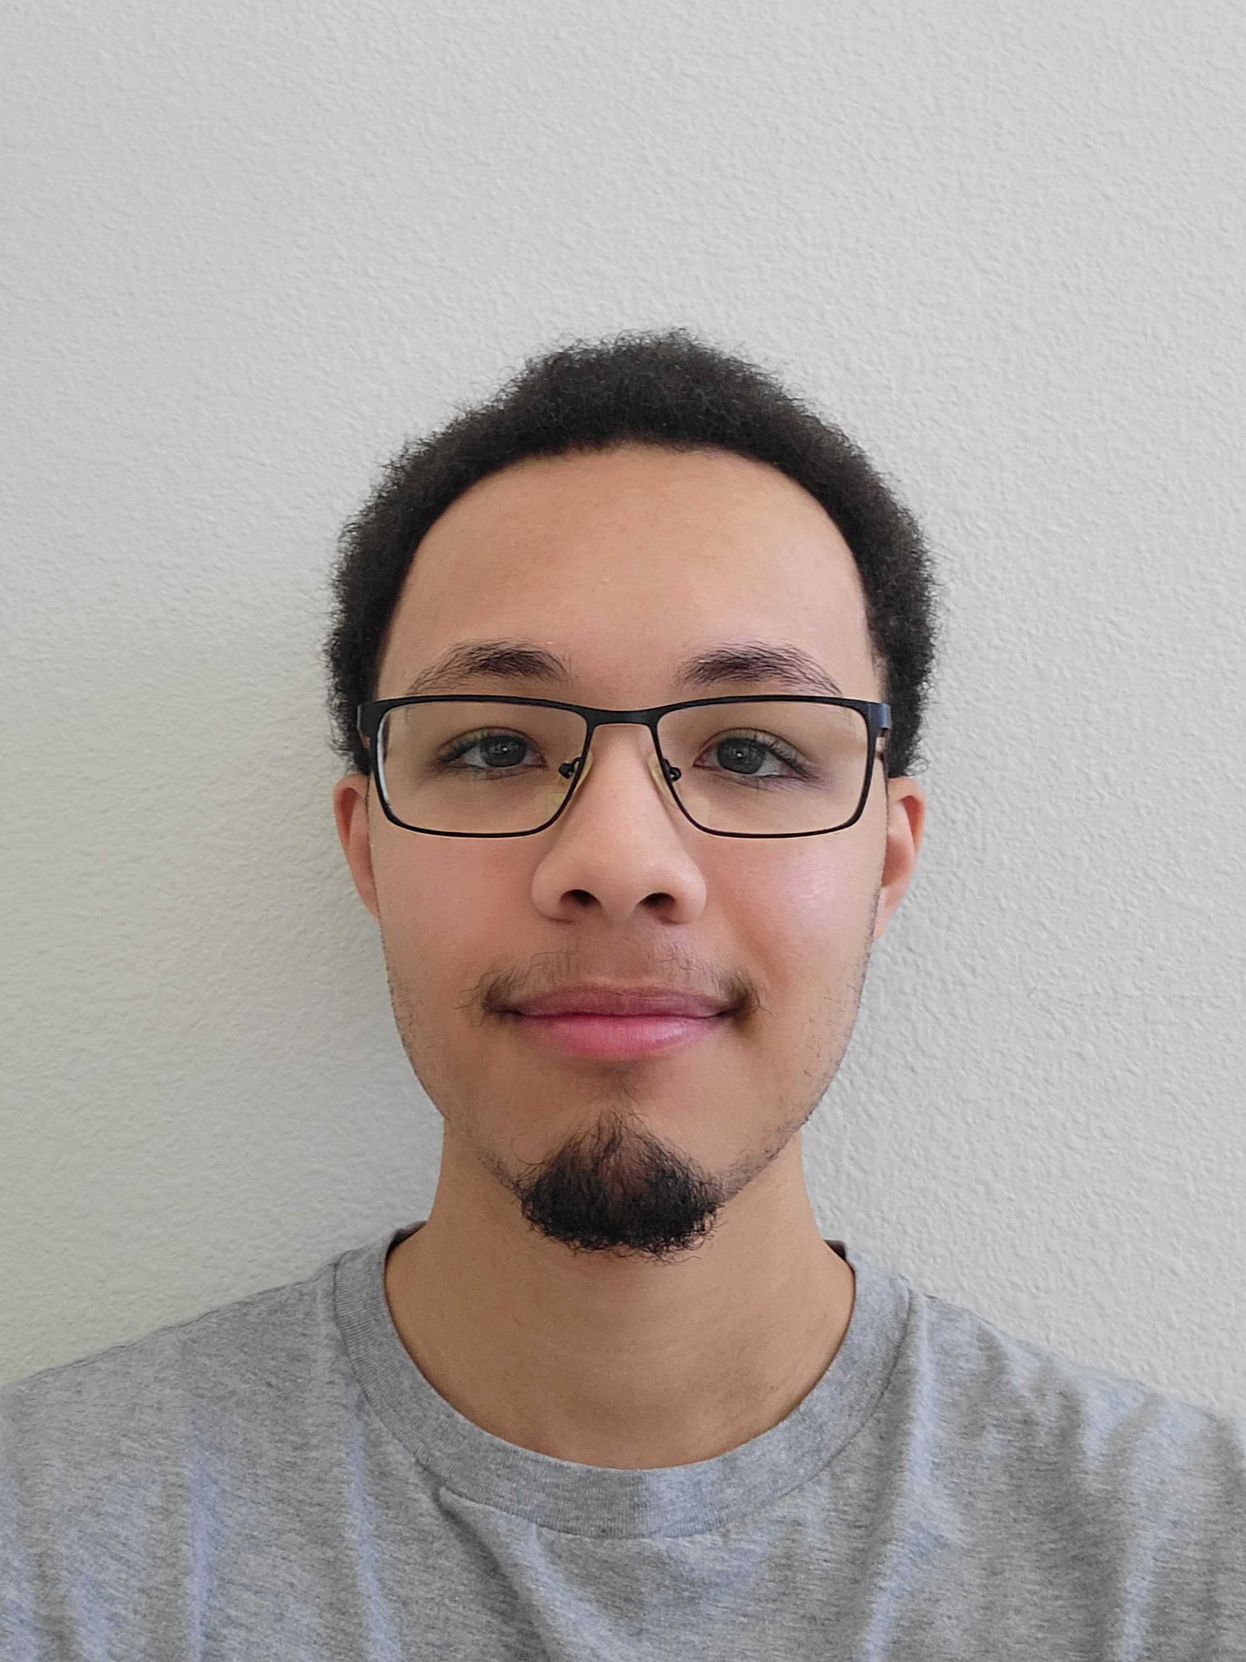
Andrew Reyes API Developer

Slide 7
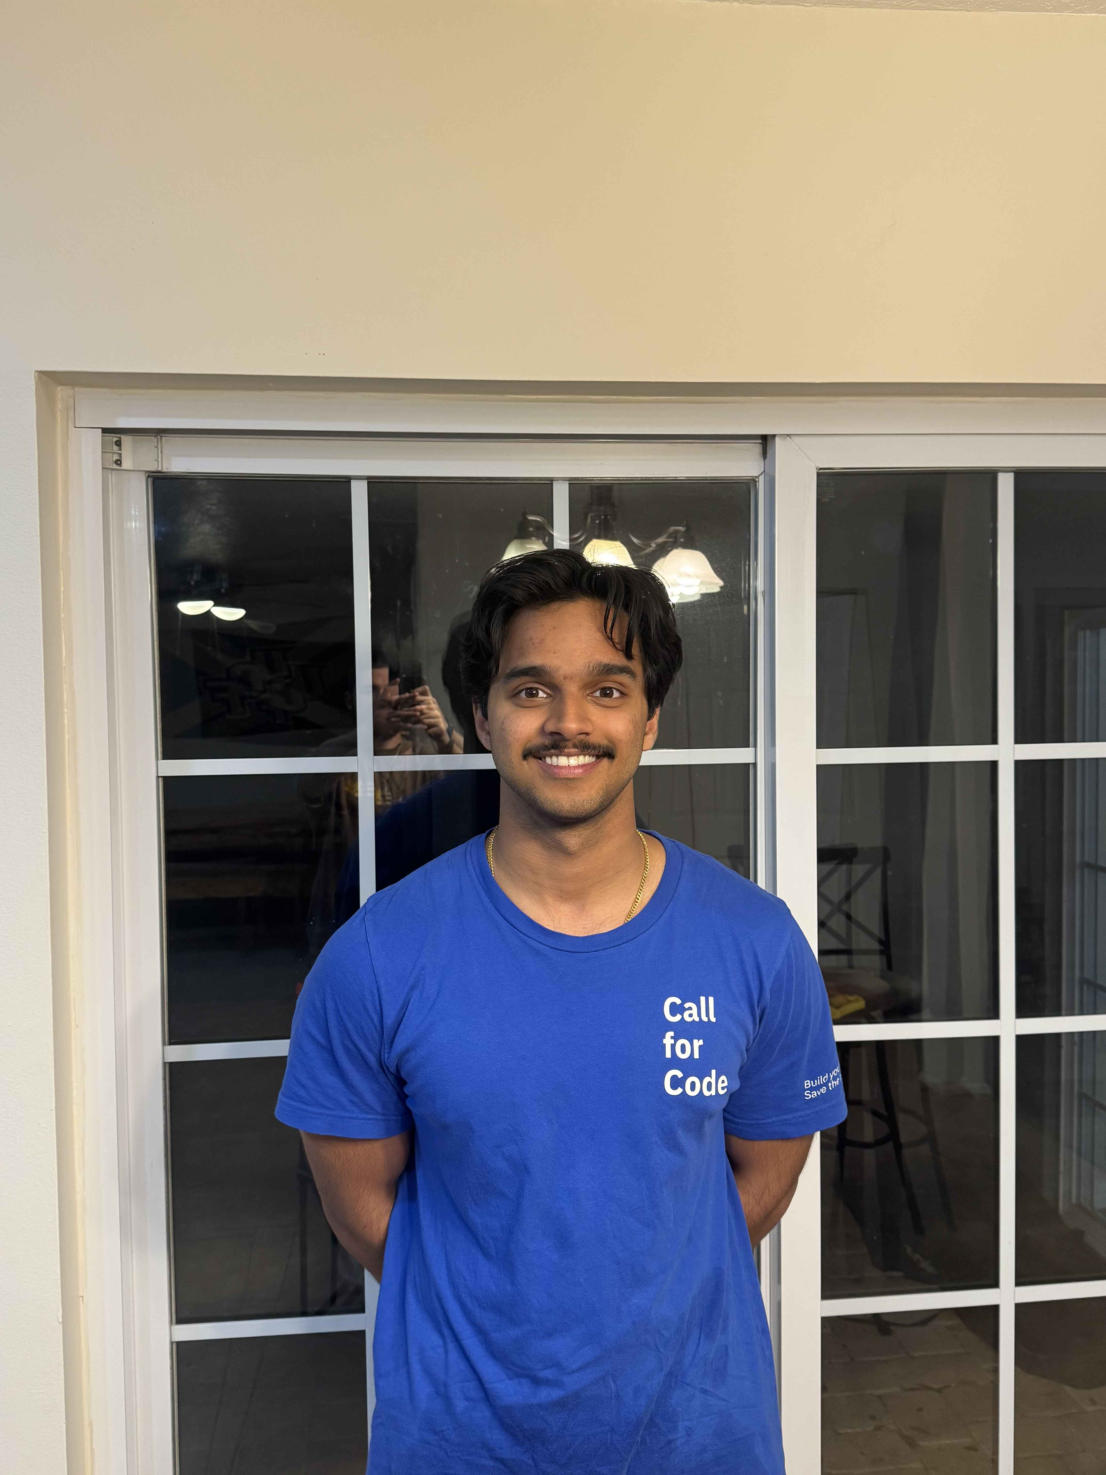
Noah Gerard API Developer
Noah’s Contributions to COPY include:
Created sign-up and login functionality
Created database connection utilities
Implemented cookie-based user session authentication
Connected initial frontend to backend for login/signup functionality

Slide 8
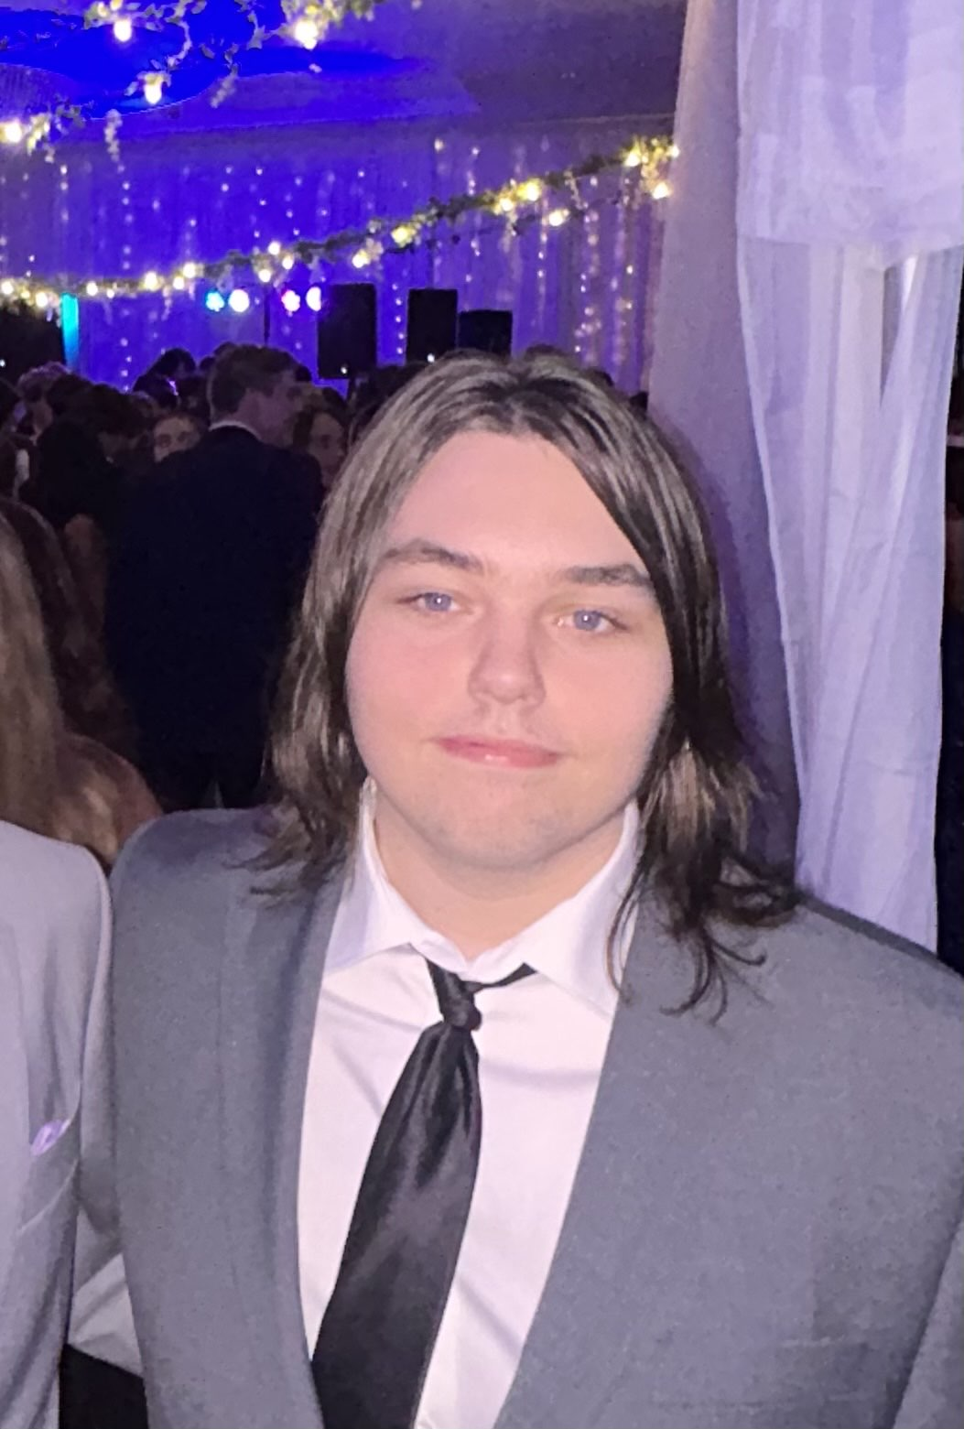
Darren Squires Database (Backend) & Frontend Developer
Darren’s Contributions to COPY Include:
Modified database schema
Made Contacts Page (front-end)
Implemented partial-searching for the contacts page
Enhanced Contacts Page API
Made the Use-Case Diagram and Entity Relationship Diagram (ERD)

Slide 9
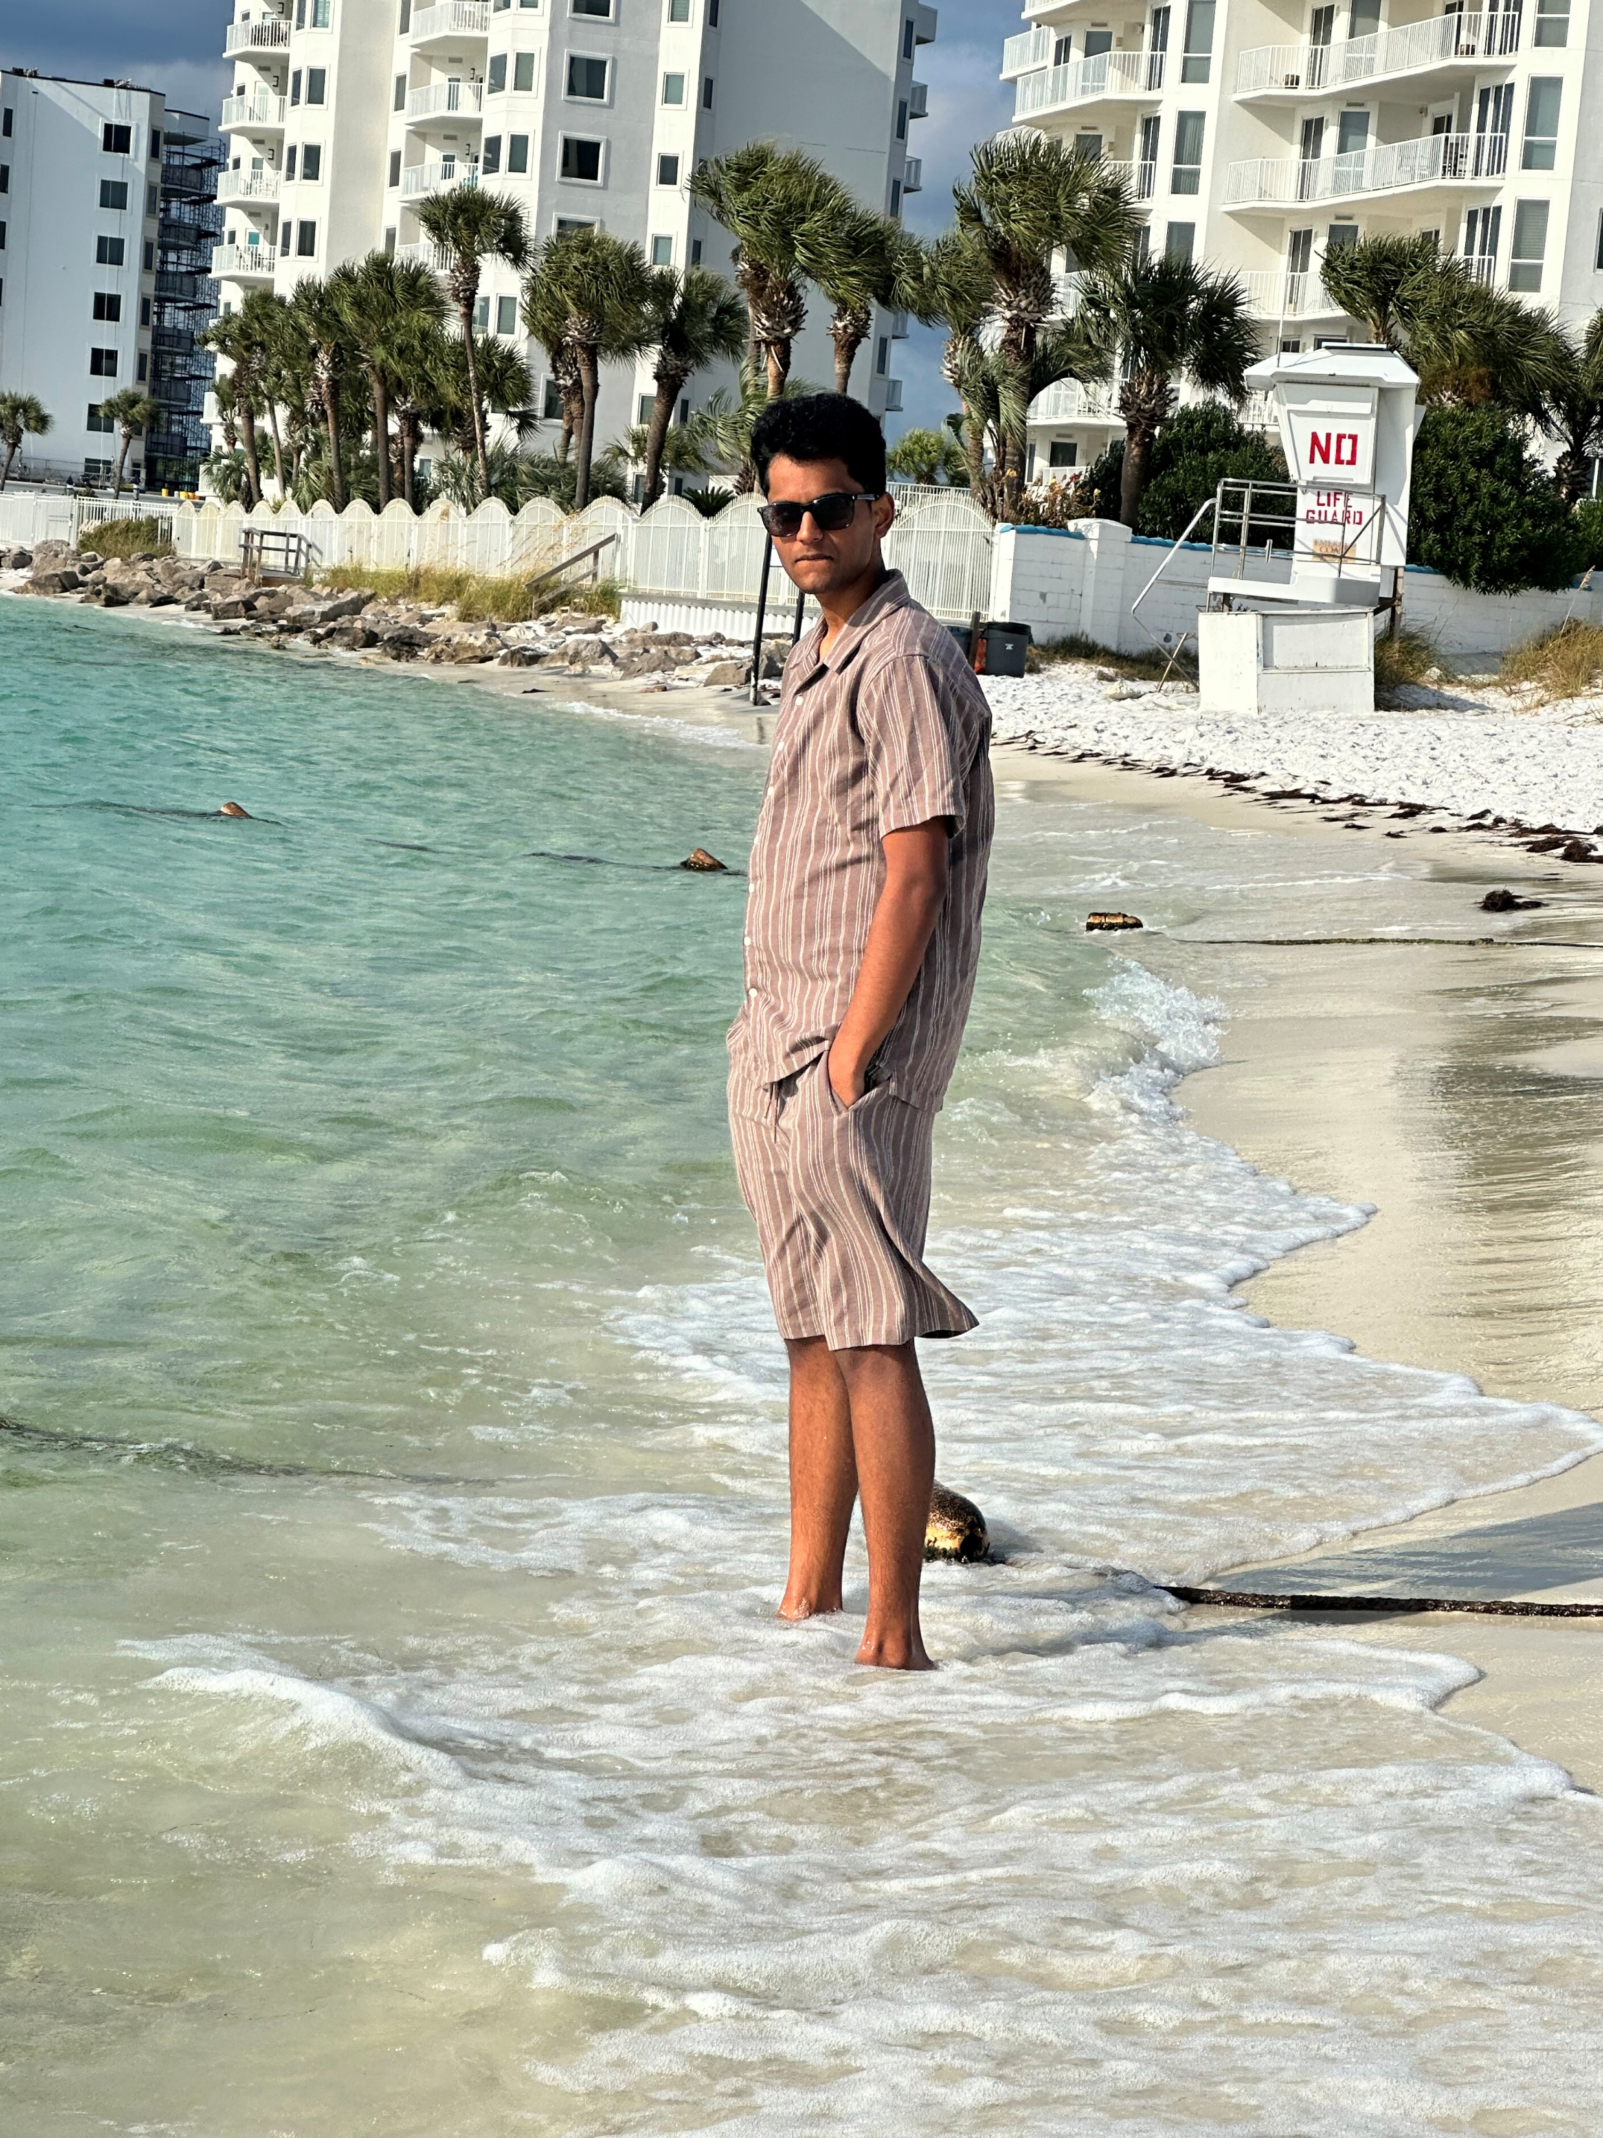
Pranav Cheruku Database (Backend) & Frontend Developer
Pranav’s Contributions to COPY Include:
Initially setup the database in the Virtual Private Server (VPS)
Coded the database to match the specifications of the project (I.E. storing each contact’s attributes, determining how to link it to the API, etc)
Added visual features to the Frontend such as: The Clock, Real-Time Error and Success Messages, and Interactive Page Navigation Buttons

Slide 10
How Did We Make COPY?

Slide 11
Communication Methods

Slide 12
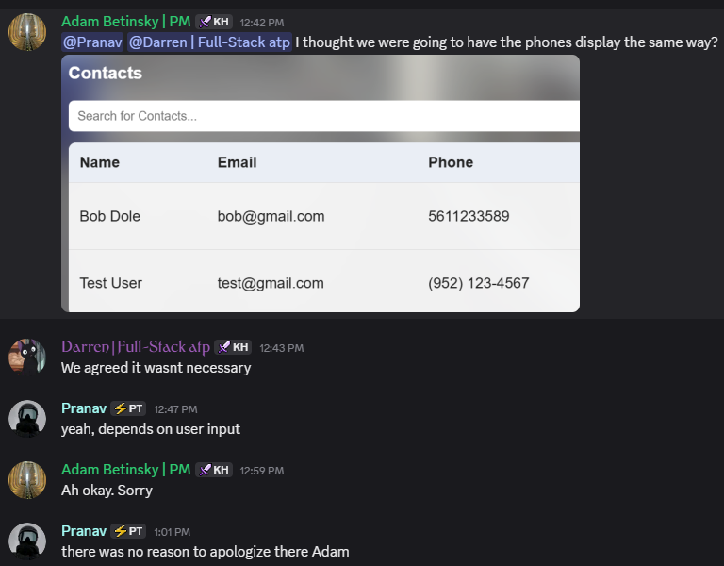

Discord
Our Primary Method of Communication:
Usually via text-based messages
Everyone communicated at least 2 times a day in the server, if not more.
We asked each other questions about implementation, concerns about code, feedback on ideas, and more.
We were able to get responses quickly, and message a specific member directly if needed.

Slide 13

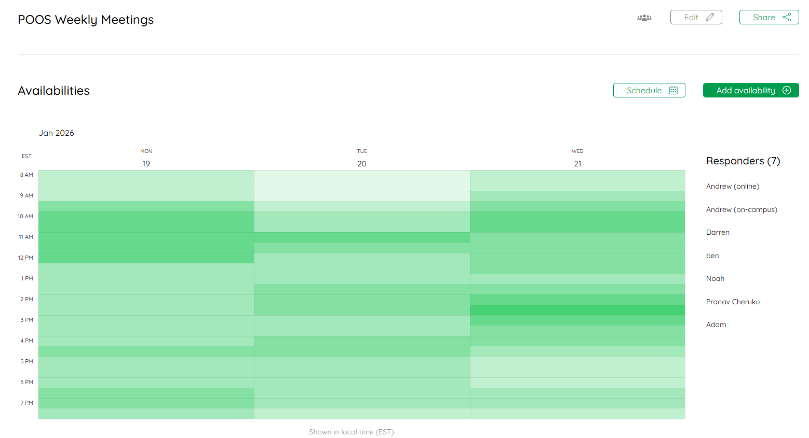
LettuceMeet
We Used LettuceMeet to Plan Our Regularly Scheduled Meetings:
We wanted to meet once per-week (virtually), on Monday, Tuesday, or Wednesday (so we could fix something on Thursday for Class on Friday if needed)
LettuceMeet allowed each tam member to enter their own availability
We were able to quickly and visually identify a team that worked best for all of us

Slide 14

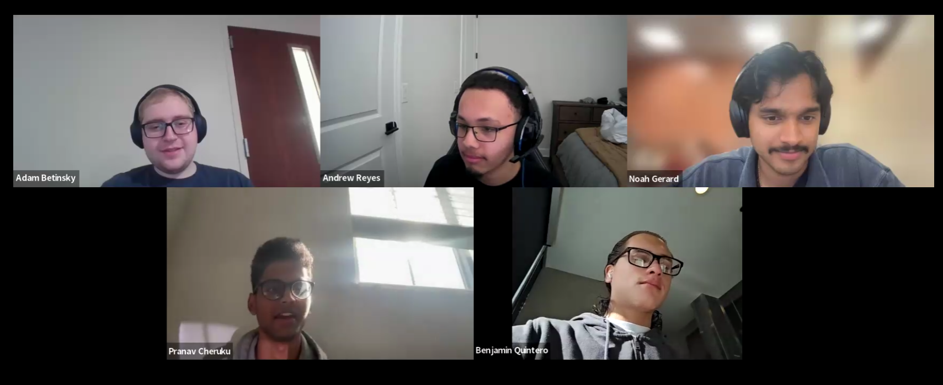
Zoom
We used Zoom to host our virtual weekly meetings on Wednesday’s from 2:30 PM – 3:00 PM :
We were able to easily update each other on progress we made, with examples and clarity (see next slide)
We were able to record each meeting should we need to review something again
It allowed to get everyone together with ease – no need to book a meeting room somewhere on campus.

Slide 15
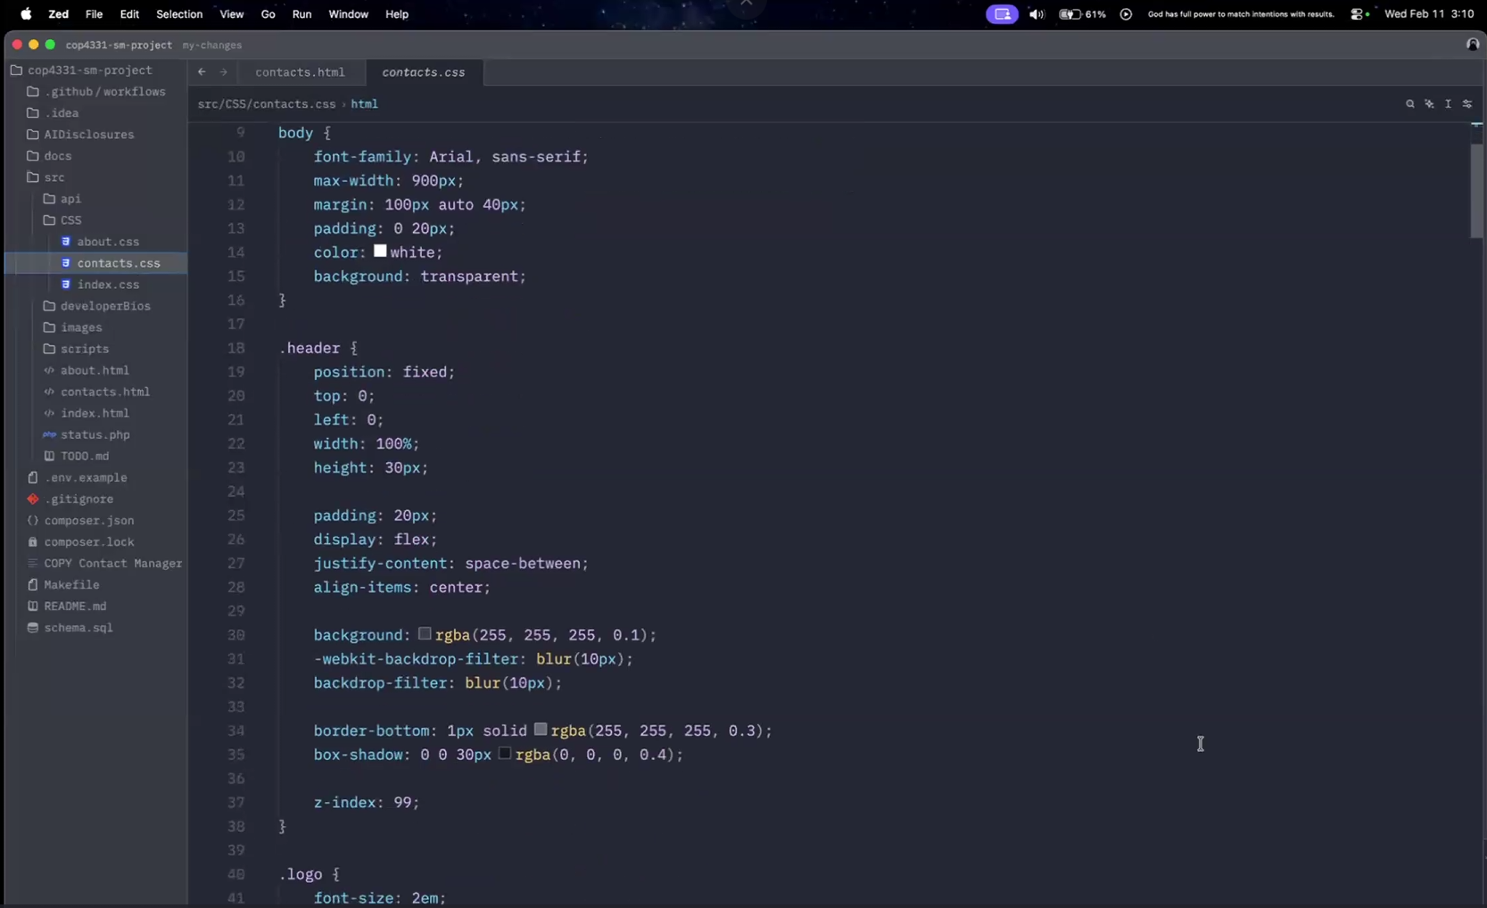
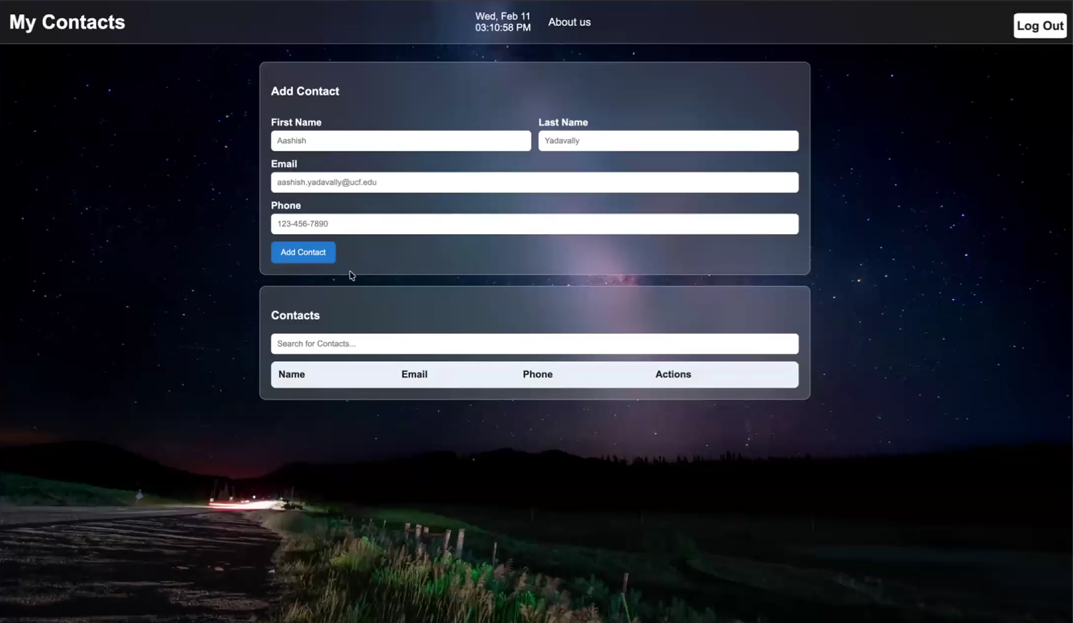

Slide 16
Version Control

Slide 17


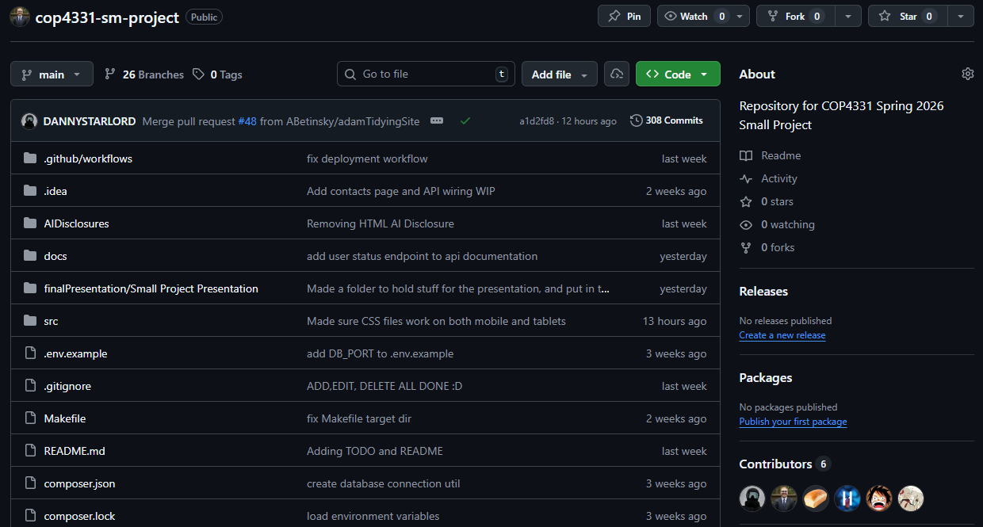
Git & GitHub
We used a Git repository to easily keep track of any changes to our code. We were able to clone the repository on each other’s devices using GitHub. GitHub also provided us real feedback to any conflicts, issues, or other concerns. Both platforms allowed for us to collaboratively see each other’s changes and easily identify if each member was doing their own part. Plus, we setup a listener on our VPS so that whenever we pushed to our Git repository, it would automatically sync on our VPS as well.
The next slide has an example of how we used Pull Requests to ensure a new feature was accurate before fully implementing a change.

Slide 18
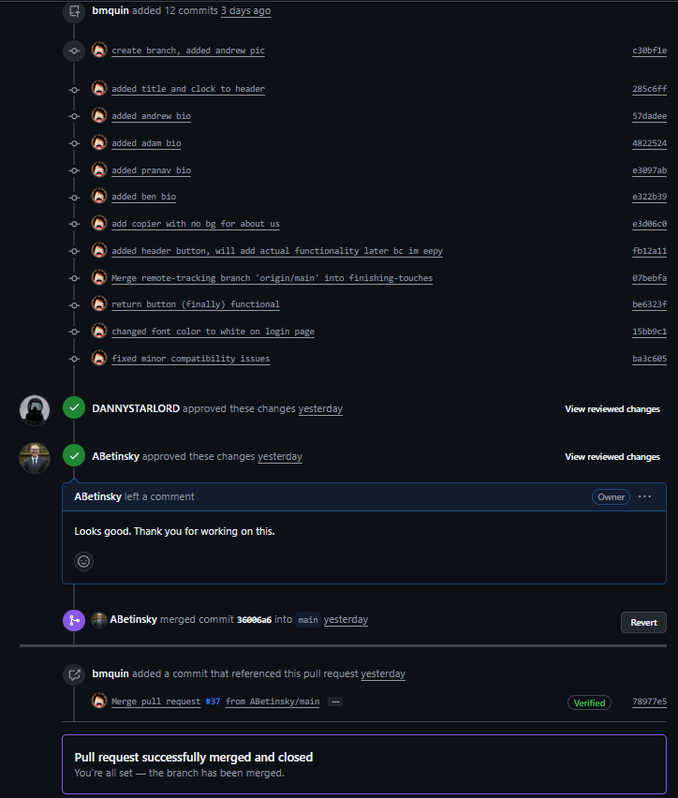
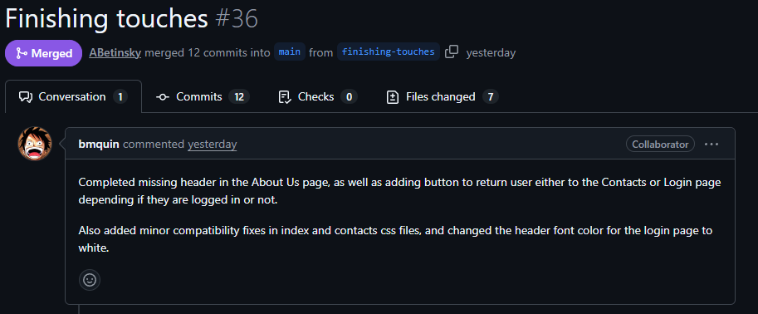

Slide 19
Frameworks, Database and Other Technologies
I need someone else to fill this in plz - Adam

Slide 20

Artificial Intelligence (AI) Usage
AI is becoming mainstream in the technology sector, and we wanted to use it as a tool. For the project, we used AI as follows:
When we decided to use AI, we mainly used ChatGPT 5.2 by OpenAI, as it’s one of the most common platforms for AI.
We primarily used AI to tutor us on things that were unfamiliar as we could receive near-instant feedback. For example, Adam used it to understand how to properly create and push to a branch on Git without overriding any other code.
We worked extremely hard to not use any code generated by AI, as not only could it be incorrect, but it would make it more challenging for us to learn the new programming languages on this website.
With that said, however, there were about 3 times we did use small segments of code generated by AI. When we did, we ensured to fill out an AI disclosure and promptly review all code for accuracy.

Slide 21
How Did The Development Progress?

Slide 22
Gantt Chart
TO BE ADDED!!! ADAM – DO THIS

Slide 23
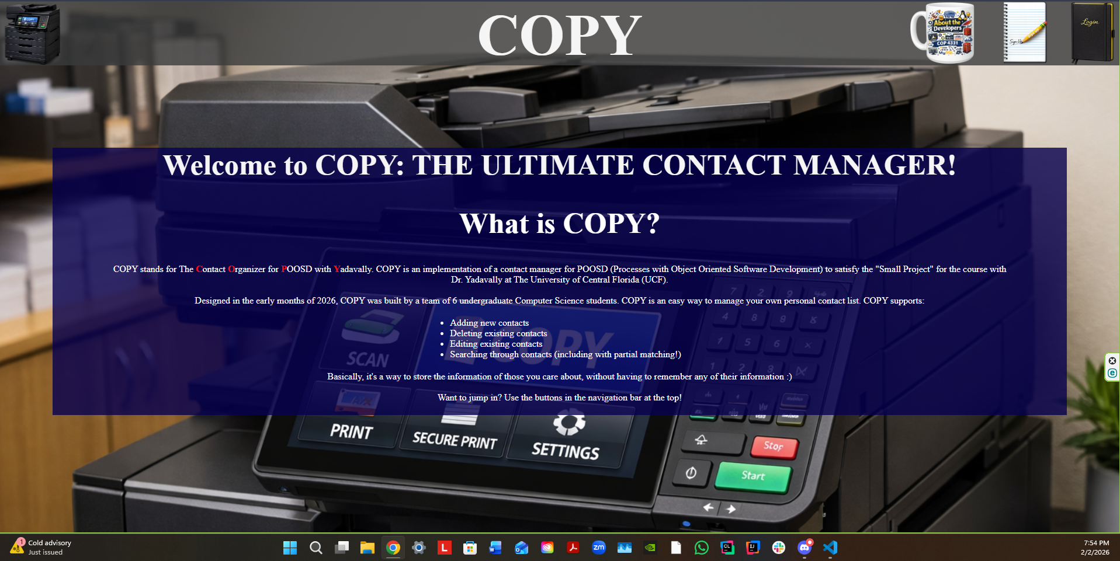
Things That Did Go Well
We got to work right away – We had the server, Git repository and domain ready to go by the beginning of week 2
We made sure to reach out to each other if we had different ideas, issues, or general concerns
We helped each other out when trying to learn something new
We ensured that we made decent progress to keep the project on schedule, while doing our best to follow the project’s requirements
We ensured that each member of the team was valued and understood

Slide 24
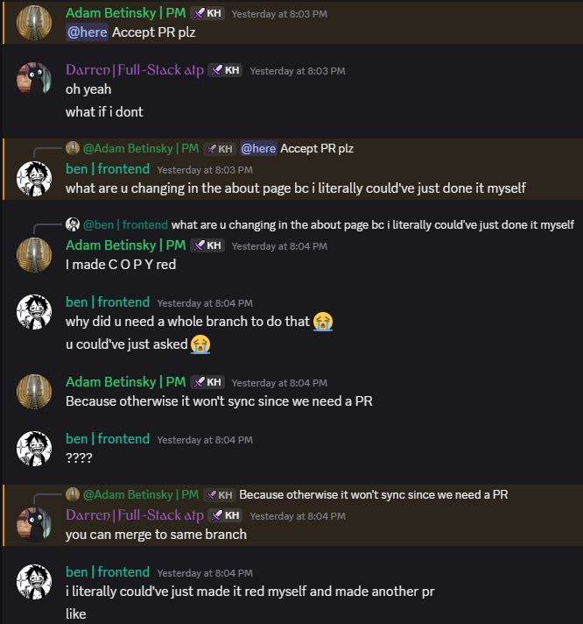
Things That Did NOT Go Well
We had conflicts from time-to-time. Whether it be about different ideas for the website design, how to organize the Git repository, or arguing over who should do a task, it was inevitable
We had a few occasions where some group members slacked a little and didn’t do their part. We would sometimes have to remind each other to get stuff done on time and/or respond to their messages
We had some miscommunication and confusion at times with the project requirements and/or implementation. For example, we didn’t realize we needed pull requests in our GitHub repository until week 5

Slide 25
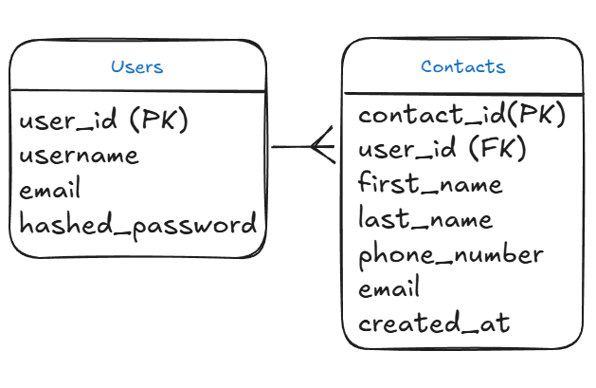
ERD Chart
DARREN – Add in information here

Slide 26
SwaggerHub API Demonstration
IDK if we need this, but figured I’d add for now

Slide 27
Demonstrations

Slide 28
Website Demonstration
ADD GIF OR VIDEO HERE – May be actual live demonstration

Slide 29
API Demonstration
ADD GIF OR VIDEO HERE – May be actual live demonstration

Slide 30
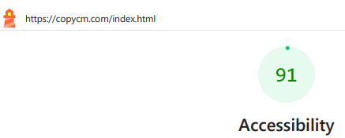
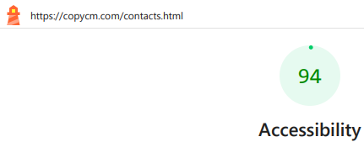
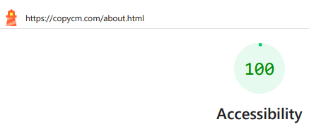
How Did We Do In Terms of Accessibility?
For all 3 of our Frontend pages, we had Lighthouse scores in the “Excellent” Range. Each page’s score was 91 or higher, on both Desktop and Mobile devices This means that we tackled accessibility concerns well overall.
With that said, however, there are some areas that could be improved further. For example, we lost some points on the score for the contacts page since we didn’t have a “main landmark”. Without this, those who rely on screen readers will likely have more difficulty using the crucial portions of the website.

Slide 31
Assumptions and Limitations
Remove this?? Ask the team

Slide 32
Any Questions?

Slide 33
Images Used in This Presentation
Main Background: https://www.pexels.com/photo/lines-of-code-2653362/
Discord Logo: https://www.vecteezy.com/vector-art/6892625-discord-logo-icon-editorial-vector
LettuceMeet logo: https://x.com/lettucemeetapp
Zoom Logo: https://1000logos.net/zoom-logo/
Git Logo: https://www.google.com/imgres?q=git%20logo&imgurl=https%3A%2F%2Fgit-scm.com%2Fimages%2Flogos%2Fdownloads%2FGit-Icon-1788C.png&imgrefurl=https%3A%2F%2Fgit-scm.com%2Fcommunity%2Flogos&docid=CMTH9vchny6mPM&tbnid=jpq4xLgv36ZQ1M&vet=12ahUKEwjlx6X8muKSAxWKmmoFHdFvE2QQnPAOegQIIBAB..i&w=383&h=383&hcb=2&ved=2ahUKEwjlx6X8muKSAxWKmmoFHdFvE2QQnPAOegQIIBAB
GitHub Logo: https://pixabay.com/vectors/github-github-logo-github-icon-6980894/
ChatGPT Logo: https://logovent.com/blog/chatgpt-logo-history/

Slide 34
Thank You!

